Slide 1
Data Management Planning at UiB ELIXIR Data Management Planning workshop 26.09.2022
Jenny Ostrop
University of Bergen Library
Research Data Team

Slide 2

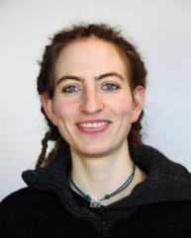
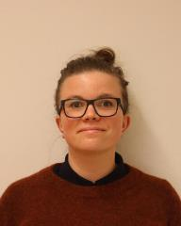
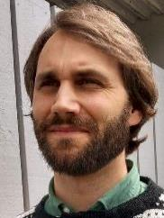
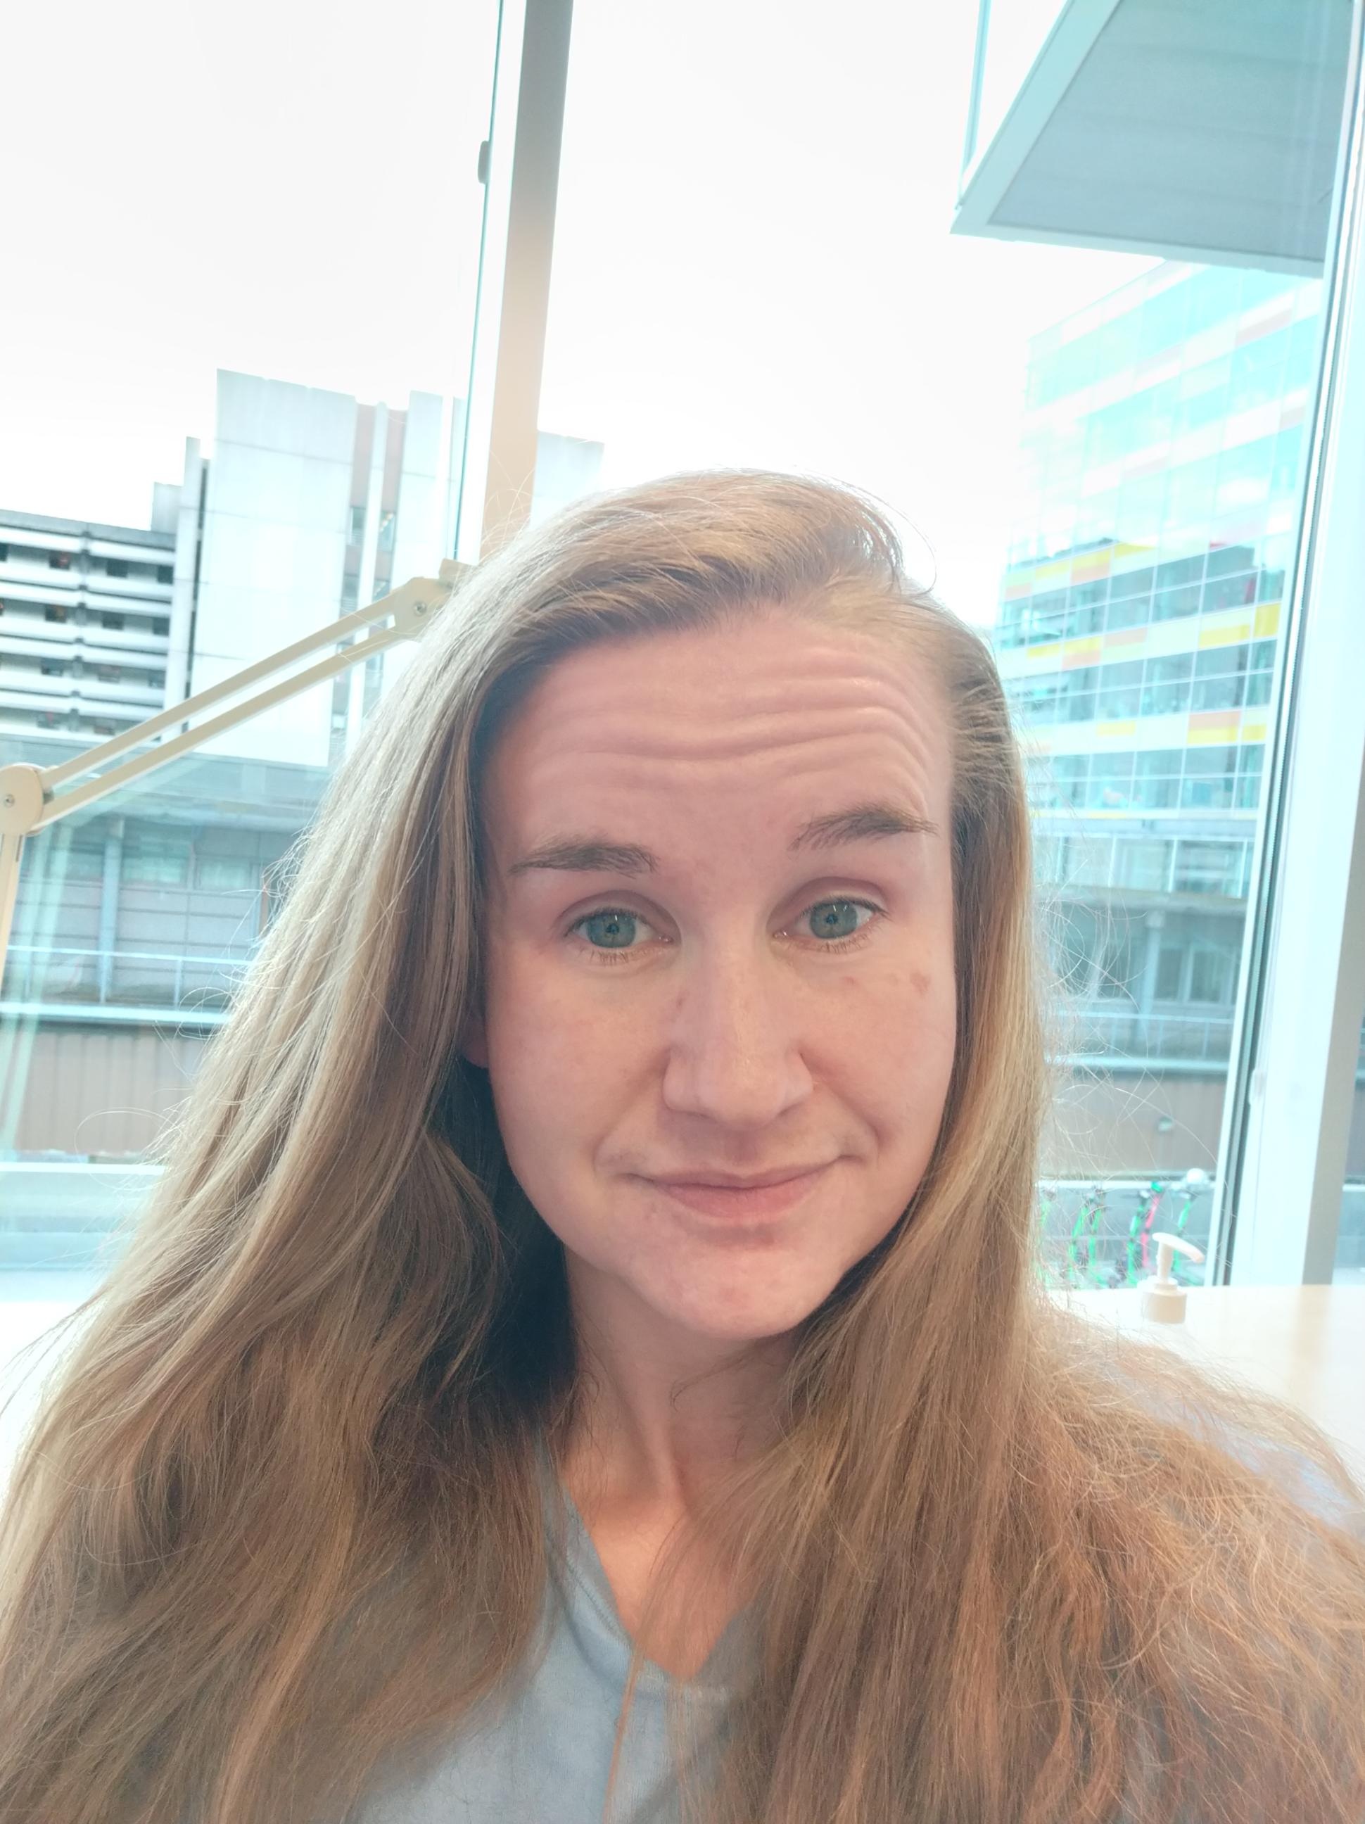
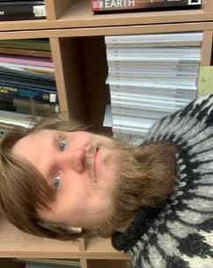

University Library Research Data Team
Courses and guidance: More information on our web pages:
Open Science Open Access to Research data
Open Data: why, how and where? Data Management Plans
Data Management Plans
Finding & reusing research data Contact us: research-data@uib.no
UiB Open Research Data

Slide 3
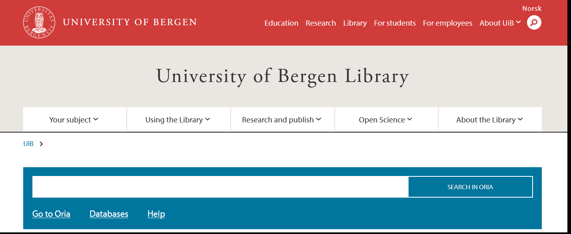
The library provides guidance
Publishing strategies for researchers
DMP
OA publishing, Publishing deals, Publication Fund
Open Access to Research Data
https://www.uib.no/ub

Slide 4
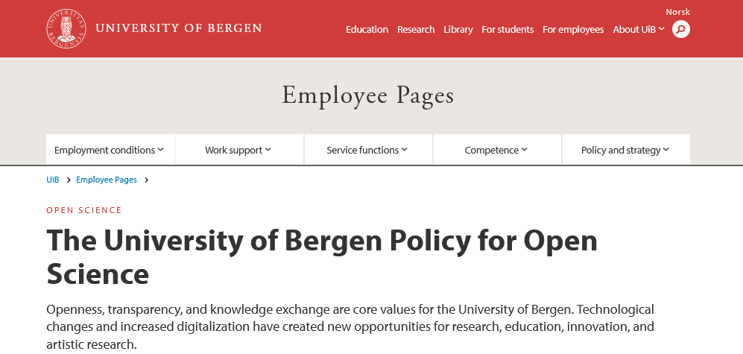
Adopted by the University Board on September 24, 2020
https://www.uib.no/en/foremployees/142184/university-bergen-policy-open-science

Slide 5

UiB Policy for Open Science
Open access to research publications and artistic research
Open access to research data
Open Innovation
Citizen Science
Open educational resources
adopted by the University Board 24.09.2020
https://www.uib.no/en/foremployees/142184/university-bergen-policy-open-science

Slide 6
Open access to research data
The goal of the University of Bergen is that data resulting from research activity should be made readily available for reuse in accordance with FAIR-principles.
https://www.uib.no/en/foremployees/142184/university-bergen-policy-open-science

Slide 7



Data description
Metadata & data quality
Storage & Backup
Legal & ethical issues
Long-term preservation & sharing
Responsi-bilities & resources
Science Europe – Practical Guide to the International Alignment of Research Data Management
FAIR-Aware Additional Guidance to the Science Europe DMP assessment rubric; DCC – DMP checklist

Slide 8

Data description
Metadata & data quality
Storage & Backup
Legal & ethical issues
Long-term preservation & sharing
Responsi-bilities & resources
Resources at
FAIR-Aware Additional Guidance to the Science Europe DMP assessment rubric; DCC – DMP checklist

Slide 9
Storage & Backup
Data description
Metadata & quality
Legal & ethical issues
Long-term preservation & sharing
Responsi-bilities & resources
How will data and metadata be stored and backed up?
use institutionally managed storage with automatic backup (NOT: laptops, stand-alone hard drives, USB sticks! Follow 3-2-1 rule if you cannot rely on managed storage)
Do you have sufficient storage resources?

Slide 10
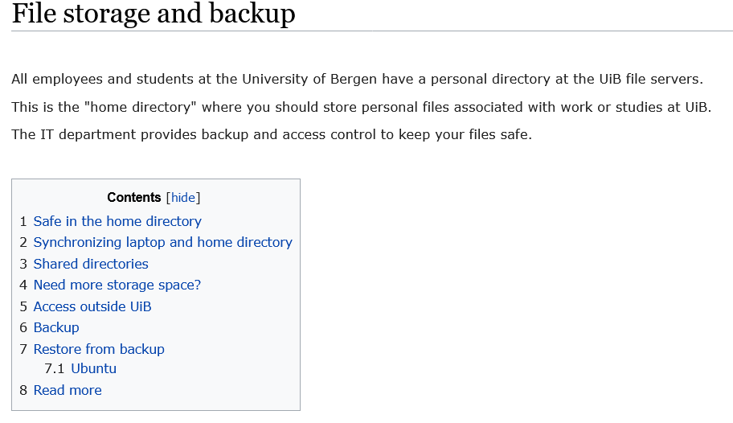
File storage at UiB IT
Default: 50GB in personal directory & 1TB on OneDrive
Price list active storage: https://it.uib.no/Prisliste_IT_tjenester
Long-term storage (cold storage): https://it.uib.no/Billy
Contact via UiBhjelp
https://it.uib.no/en/File_storage_and_backup

Slide 11



Large datasets (TB range)
Sigma2 & NIRD
Subject-specific platforms
(storage based on NIRD)
INES
https://www.sigma2.no/; https://www.sigma2.no/nird-service-platform

Slide 12
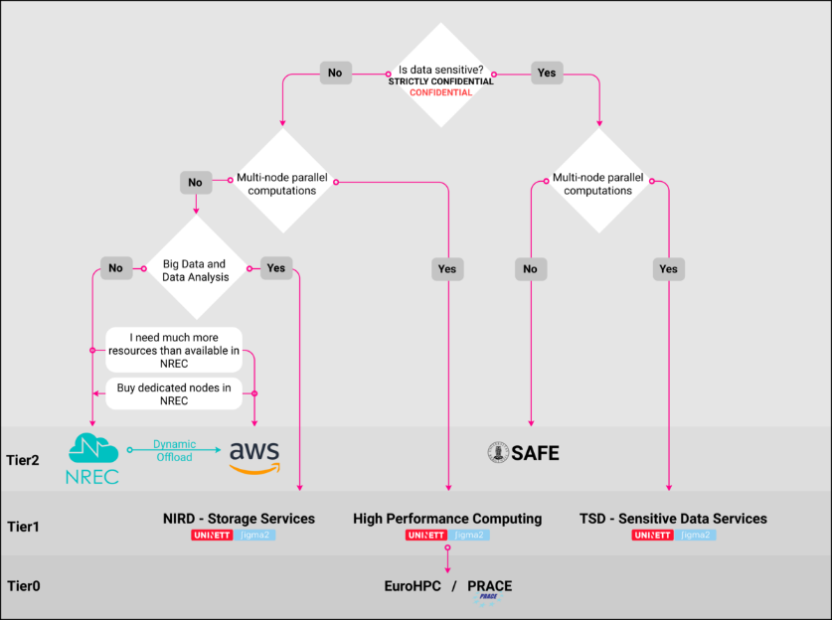
High-performance computing (HPC)
HPC training events: https://www.sigma2.no/training
https://wiki.uib.no/hpcdoc/index.php/Main_Page

Slide 13
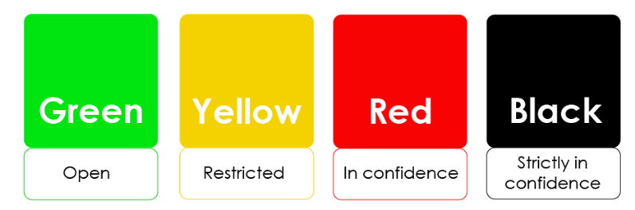
Storage & Backup
Data description
Metadata & quality
Legal & ethical issues
Long-term preservation & sharing
Responsi-bilities & resources
How is data security and protection of sensitive data taken care of?
many types of personal data
special category (personal sensitive) data
large amounts of special category data
https://www.uib.no/lagring; https://www.uio.no/english/services/it/security/lsis/data-classes.html

Slide 14
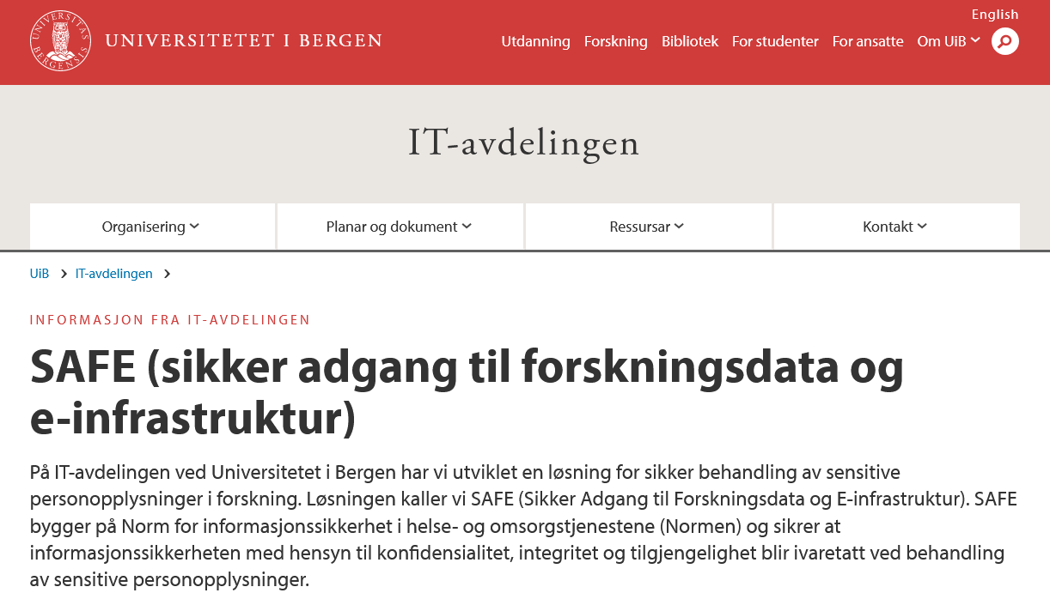
Storage & Backup
Data description
Metadata & quality
Legal & ethical issues
Long-term preservation & sharing
Responsi-bilities & resources
How is data security and protection of sensitive data taken care of?
If you have sensitive data @UiB
SAFE
https://www.uib.no/safe
many types of personal data
special category (personal sensitive) data
large amounts of special category data
https://www.uib.no/lagring; https://www.uio.no/english/services/it/security/lsis/data-classes.html

Slide 15
Storage & Backup
Legal & ethical issues
Data description
Metadata & quality
Legal & ethical issues
Long-term preservation & sharing
Responsi-bilities & resources
What legal/ethical issues are there and how will they be taken into account? Which legislation is applicable?
Processing of personal data, how will compliance with legislation and data security be ensured?
How will intellectual property rights (IPR) and ownership be managed?
What ethical issues and codes of conduct need to be considered?

Slide 16
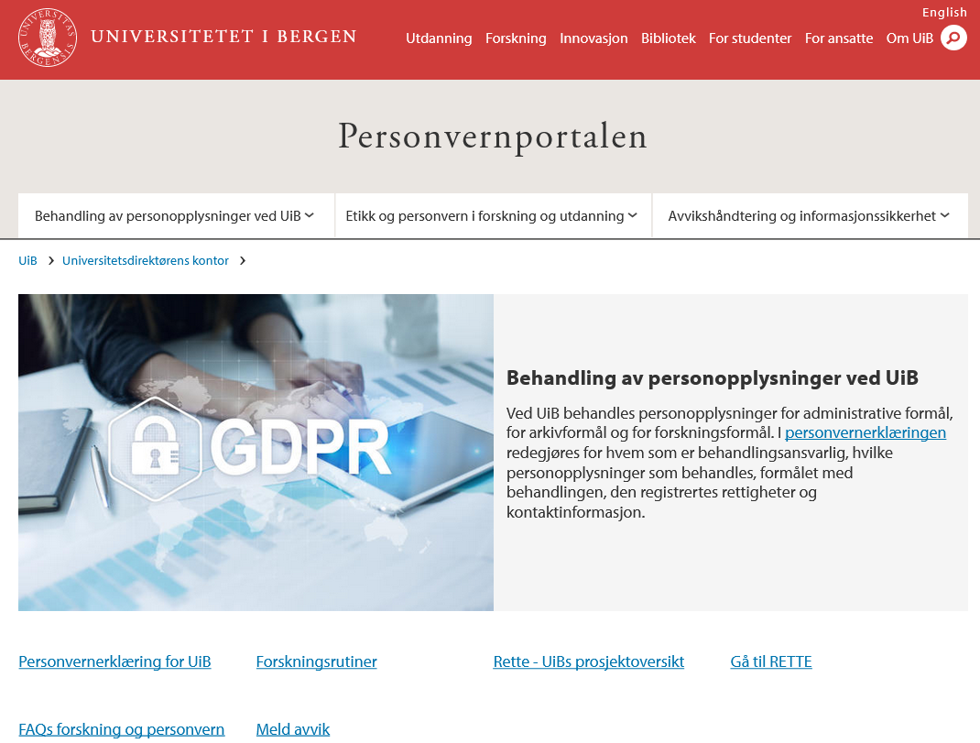
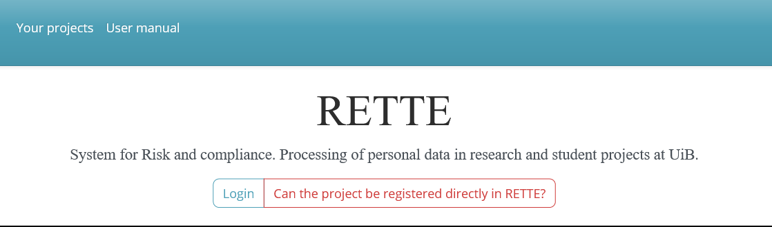
Personal Data and Privacy Gateway (Personvernportalen)
UiB’s data protection officer (Personvernombud): Janecke Veim
Mandatory registration: RETTE
https://www.uib.no/en/personvernportalen [English: less information]
https://rette.app.uib.no/

Slide 17
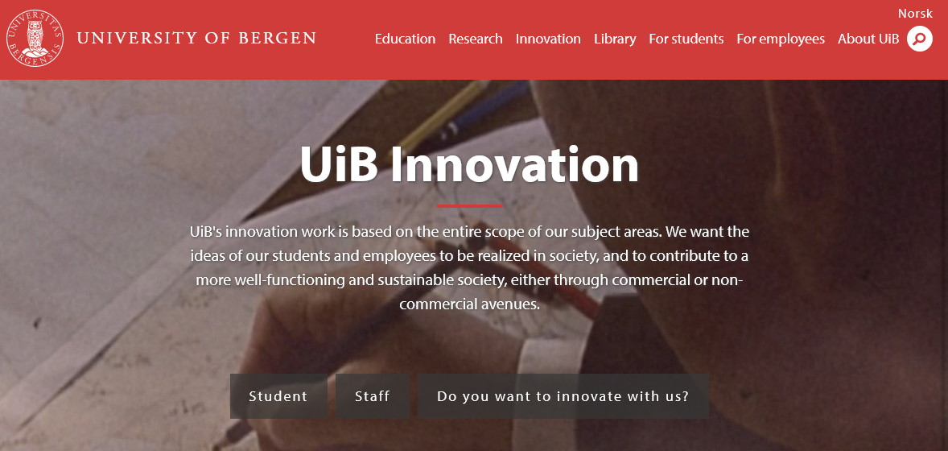
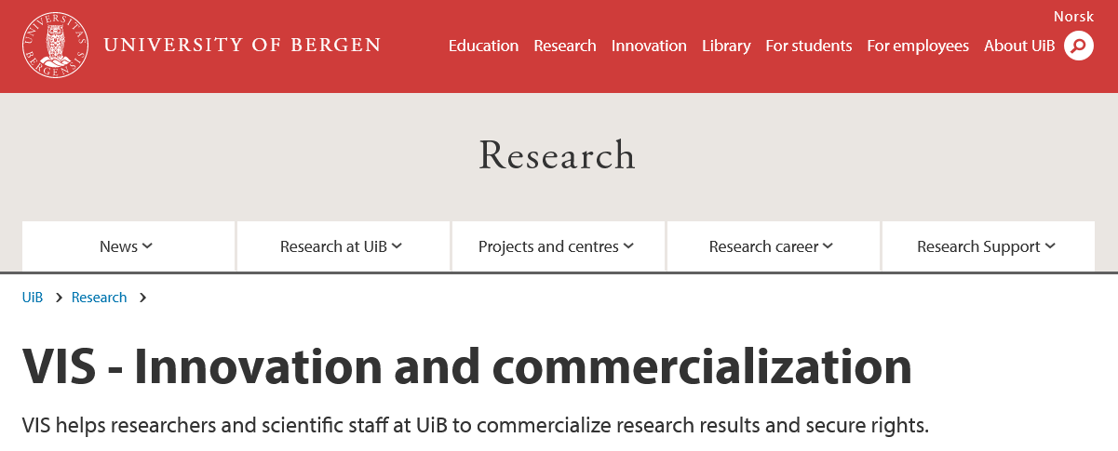
Intellectual Property Rights (IPR)
https://www.uib.no/en/innovation
https://www.uib.no/en/research/74837/vis-innovation-and-commercialization

Slide 18
Storage & Backup
Legal & ethical issues
Long-term preservation & sharing
Data description
Metadata & quality
Responsi-bilities & resources
Which data repository/archive are you planning to submit to?
Describe persistent identifiers, file formats, metadata standards, controlled vocabularies,... → compliance with FAIR principles
Restrictions to data sharing? (information security, IPR,...)

Slide 19




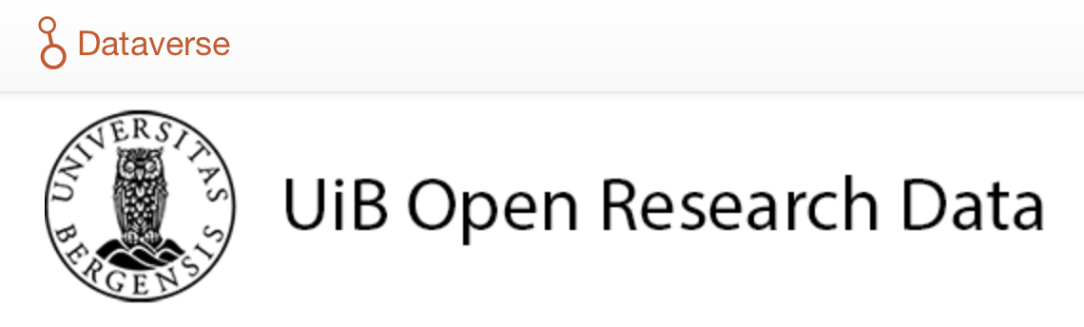



Data repositories
Community repository
Institutional repository
Multidisciplinary repository

Slide 20
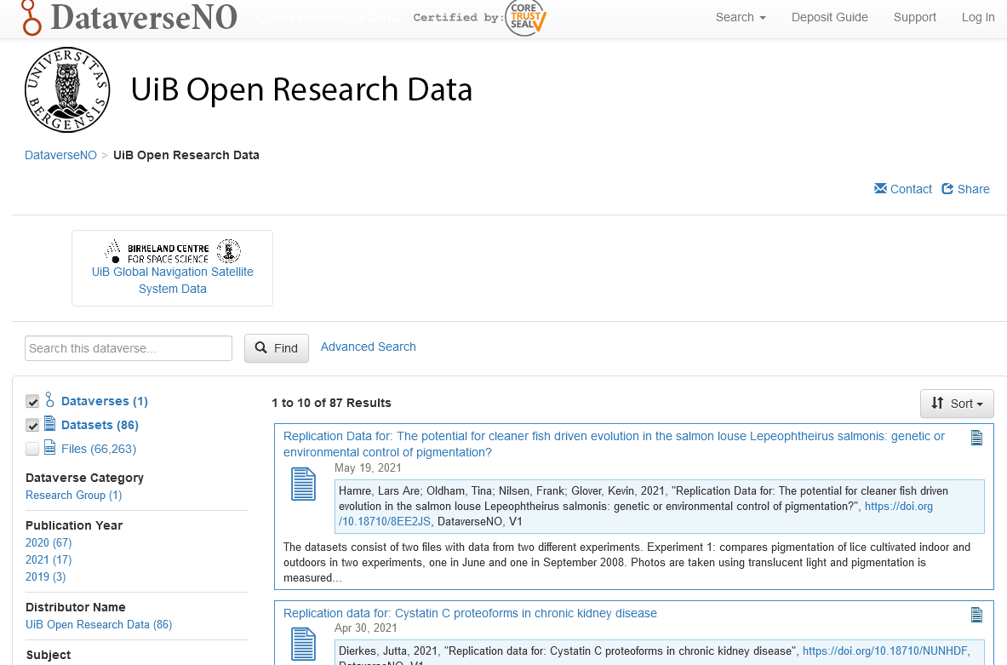
UiB Open Research Data
https://dataverse.no/dataverse/uib; Sandbox: https://test.dataverse.no/dataverse/uib

Slide 21
Data description
Metadata & quality
Storage & Backup
Legal & ethical issues
Long-term preservation & sharing
Responsi-bilities & resources
Who will be responsible for data management?
Consider to use controlled vocabulary for role definitions (e.g. DataCite Metadata Schema contributorType)
What resources (cost & time) will be allocated to data management and ensuring that data will be FAIR?
Resources: Utrecht University – Costs of data management UK Data Service - Costing data management

Slide 22




Further resources
openscience.no
incl. event calendar
CESSDA Data Management
Expert Guide
PhD on Track - Open Science
ELIXIR RDM Kit

Slide 23







Open courses autumn 2022
16.09.
19.08.[norw.], 30.09., 25.11.
14.10.
02.09., 09.12.[norw.]
24.-28.10.
11.11.
https://www.uib.no/en/ub/calendar

Slide 24

?
?
?
?
!
research-data@uib.no
@UiB_UB @DLabUiB @jennyostrop

Slide 25

Except where otherwise noted, this work is licensed under the Creative Commons Attribution 4.0 International License

